Slide 1
FIGMA UI/UX DESIGN SHOWCASE
CRAVEYARD
Campus food delivery app · Designed and prototyped in Figma
PART 1 · DESIGN APPROACH
PART 2 · APP FUNCTIONALITIES
Abhijit Das Ayon
Md Habibur Rahman Fuyad
ID: 0182420012101038
ID: 0182420012101032
Project overview and Figma workflow
Screen-by-screen walkthrough
Notes:
Good day everyone. We are presenting CraveYard, a campus food delivery app designed and prototyped entirely in Figma. I am Abhijit Das Ayon and I will cover the project overview and how we worked in Figma. My teammate Md Habibur Rahman Fuyad will then walk you through the app screens one by one.

Slide 2

What I will cover in Part 1
Part 1 | Abhijit Das Ayon
01
02
03
04
Project overview
Collaboration
Carousels & scroll
Prototyping
The master canvas and what we built
Working together in one live file
Swipeable rows and long pages
Linking every button and flow
05
06
07
NEXT
Part 2: App walkthrough
Community kits
Figma agent & theme
Experimental pages
Reusing assets and our own parts
One consistent look across frames
Designing and testing before production
Presented by Fuyad
Notes:
Here is the roadmap. I will start with an overview of the project, then go through six parts of our Figma approach: collaboration, carousels and scrolling, prototyping, community components, the Figma agent for theming, and our experimental pages. Fuyad will then continue with the app functionalities.

Slide 3
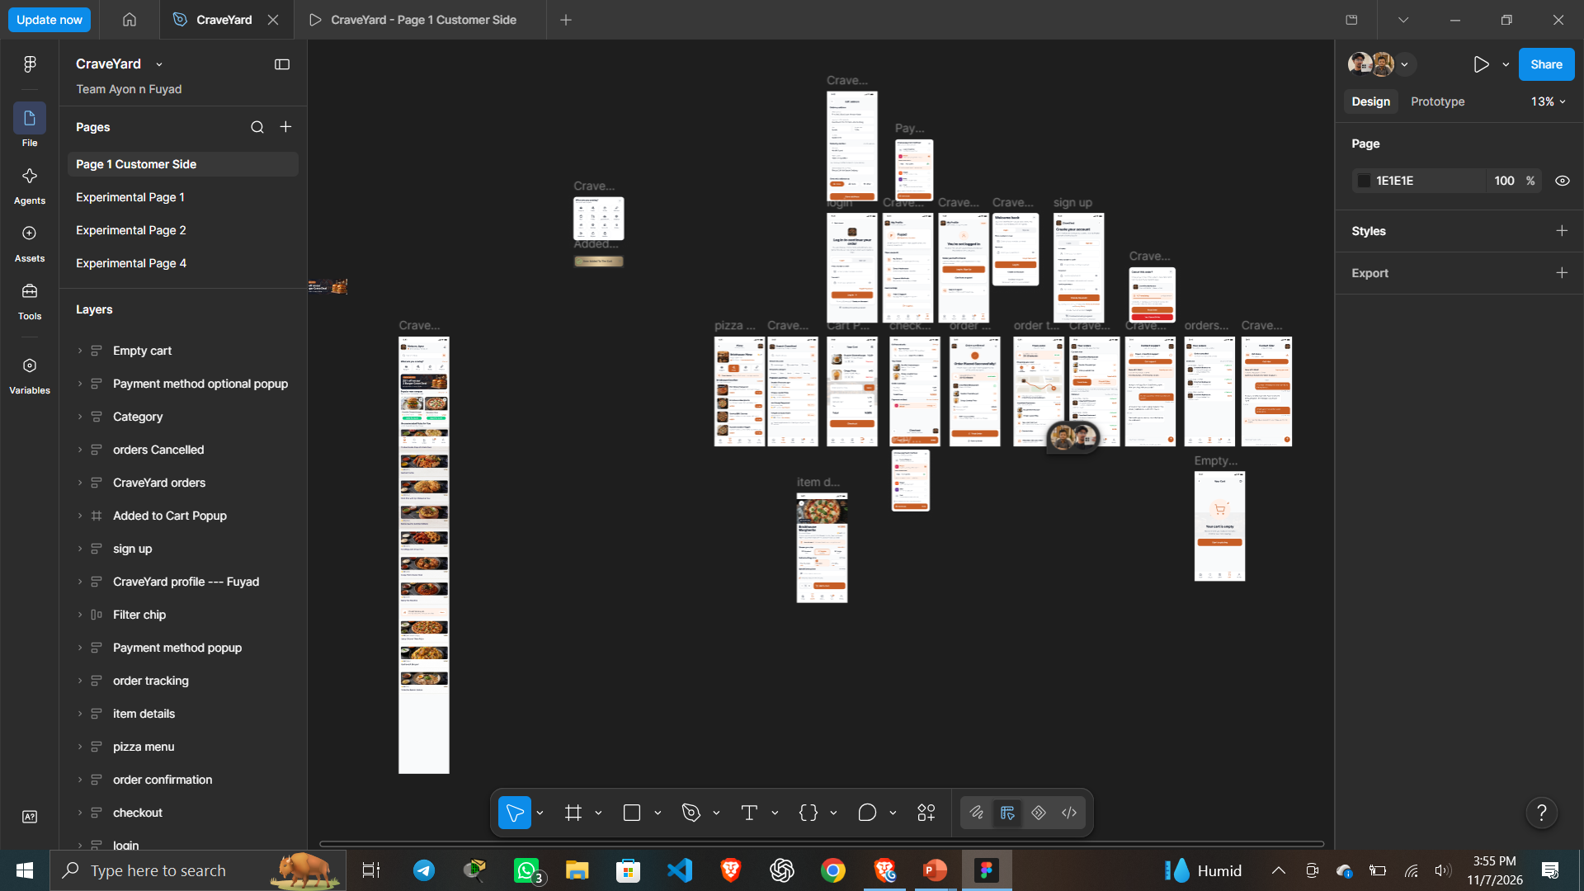
The master canvas: every screen in one place
PROJECT OVERVIEW · CraveYard
1
Page 1: Customer Side
Production page holding every mobile screen
2
Stretched Home Page
A scrollable Home Page which acts as the landing page of the app
3
24 Frames
Describing a fully working app that has currently 24 frames and more to be added later
Notes:
This is screenshot 288, our main Figma canvas on Page 1, Customer Side. The screens are laid out left to right in the order a user moves through the app, and the pop-ups and bottom sheets sit below the main flow. Having everything on one page made reviewing the whole experience easy.

Slide 4
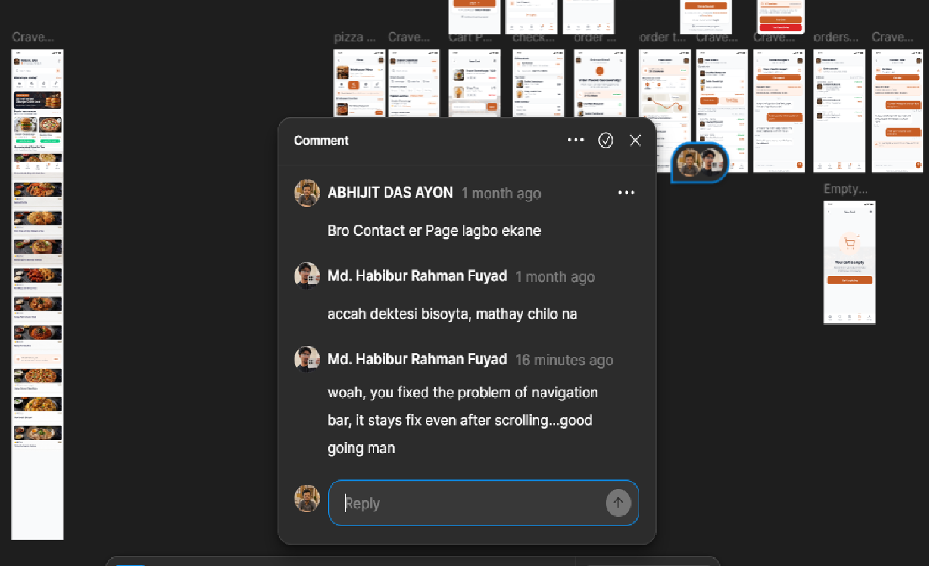
Designing together in real time
01 · COLLABORATION
1
One shared Project
No exports, no merging, always the latest version
2
Live cursors
We saw each other's edits as they happened
3
Communication
Each of us owned a set of frames and flows and communicated through comments live
Notes:
Figma is multiplayer, so we never passed files back and forth. Both of us were in the same file at once, seeing each other's cursors, splitting the screens between us and leaving comments directly on the frames. Feedback was immediate and there were no versions to merge.

Slide 5
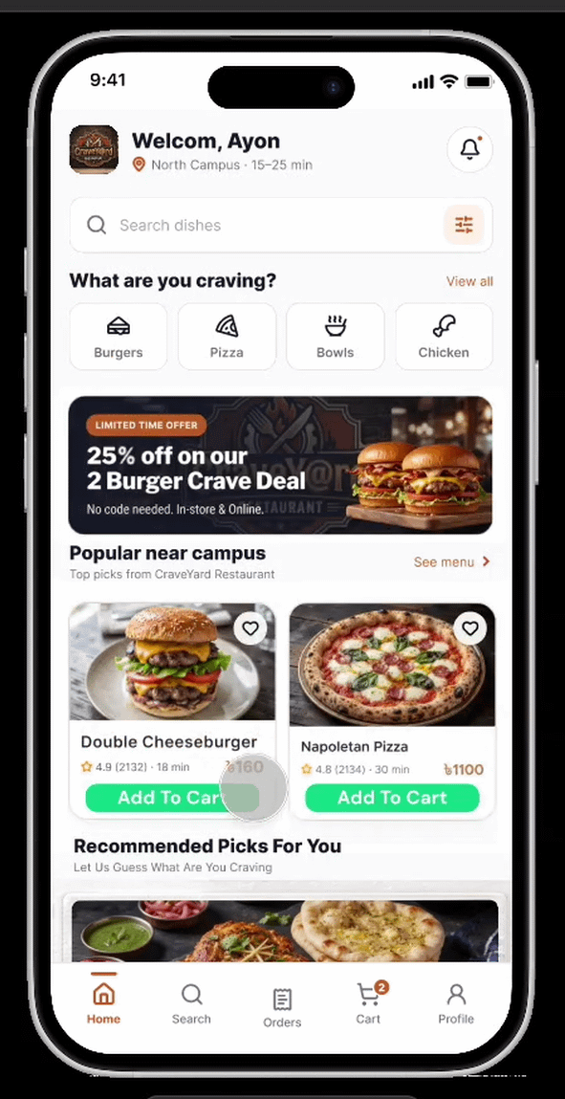
Making pages scroll like a real app
02 · SCROLLABLE PAGES
Extend the content
Stack the sections in a vertical auto layout taller than the screen
1
Pin the essentials
Fix the header and bottom tab bar so they stay in place
2
Set the scrolling
In Prototype, set Overflow scrolling to Vertical
3
Result: long pages scroll while navigation stays fixed
Notes:
Our pages are taller than the phone screen, so the content body is a vertical auto layout that extends past the frame. We pinned the top bar and the bottom tab bar using Fix position when scrolling, and set the overflow scrolling to vertical. That gives the native app feel when you preview the prototype.

Slide 6
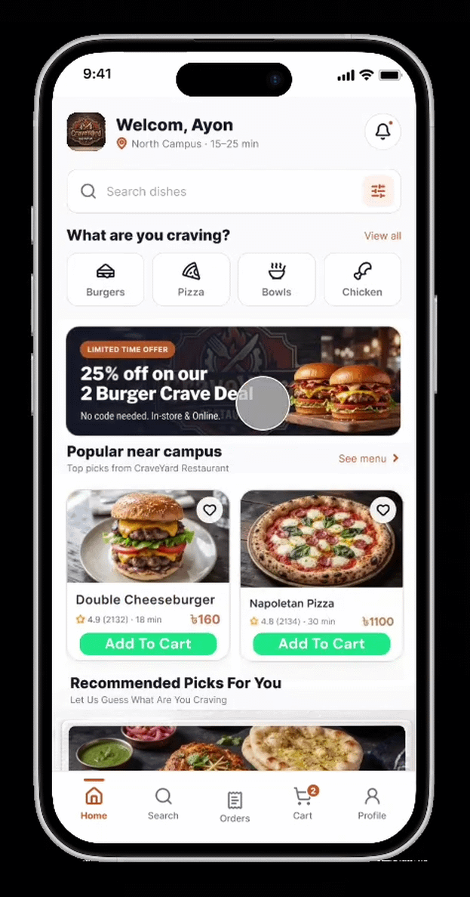
Building a swipeable carousel
03 · CAROUSELS
Build the row
Place the food cards in a horizontal auto layout with an even gap
1
Clip the frame
Keep the parent at screen width and turn on Clip content
2
Set the scrolling
In Prototype, set Overflow scrolling to Horizontal
3
Result: cards swipe sideways inside a fixed frame
Notes:
For rows like popular food and discount banners, we used a horizontal auto layout, so the cards sit evenly with a fixed gap. The parent frame is kept at screen width with Clip content on, and in the prototype we set the overflow scrolling to horizontal. The cards then swipe sideways inside the screen.

Slide 7
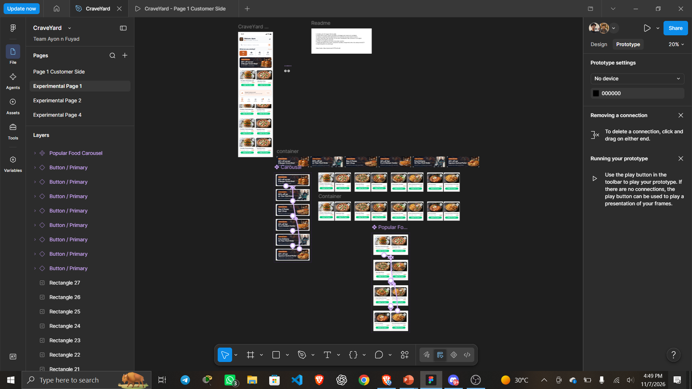
Experimenting first, then moving to production
04 · EXPERIMENTAL PAGES
1
Sandbox pages
Experimental Page 1 and 2 hold the rough ideas
2
Test in isolation
Layouts, carousels and interactions tried safely
3
Promote when ready
Only finished designs reach Page 1
Notes:
This is screenshot 289, showing the pages in our file. Besides Page 1, we kept Experimental Page 1 and 2 as sandboxes. We tried rough layouts, carousels and interactions there, and only moved a design to the main canvas once it worked. That kept the production page clean.

Slide 8
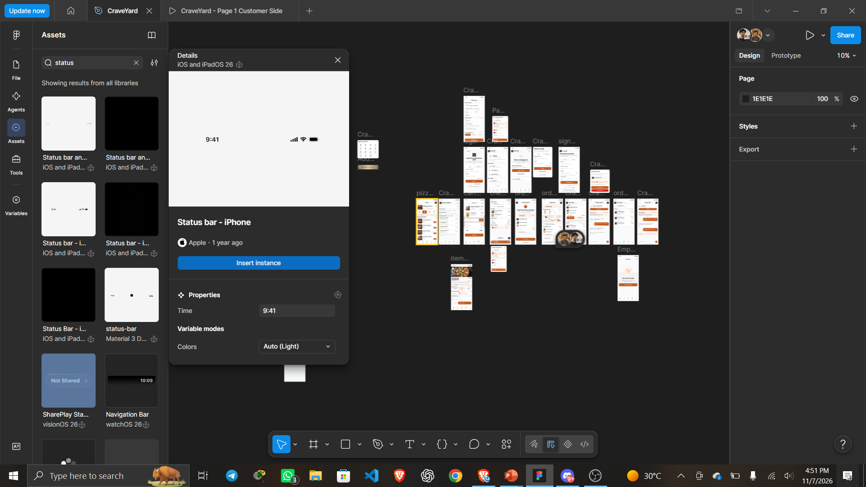
Reusing community assets to move faster
05 · COMMUNITY COMPONENTS
1
Community UI kits
iOS status bar, icons and system elements
2
Brand assets
Payment logos such as bKash, Nagad and Upay
3
Our own components
Buttons, food cards and chips reused everywhere
Notes:
Instead of redrawing everything, we used Figma Community resources for the system pieces, such as the iOS status bar, tab icons and payment logos. On top of that we built our own master components for buttons and food cards, so any change updates every screen that uses them.

Slide 9
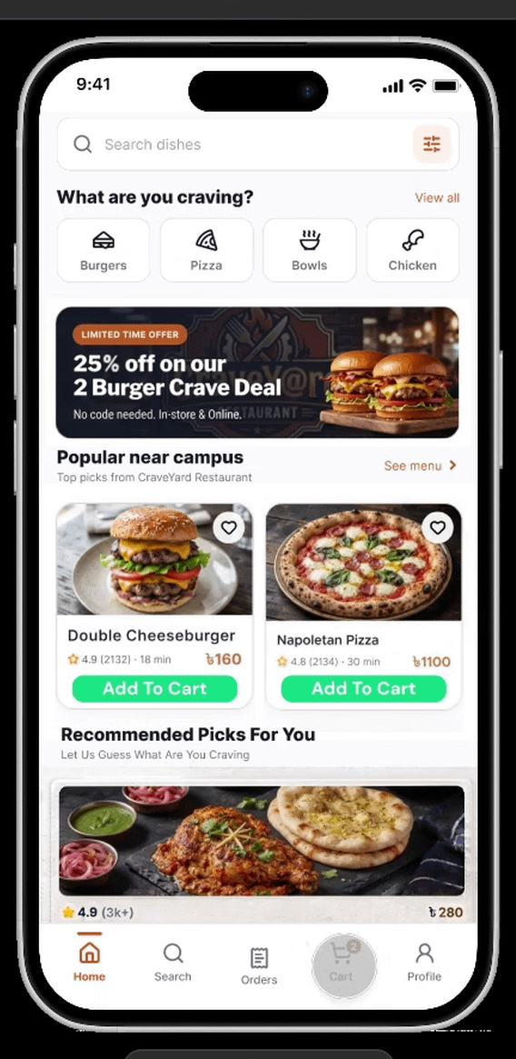
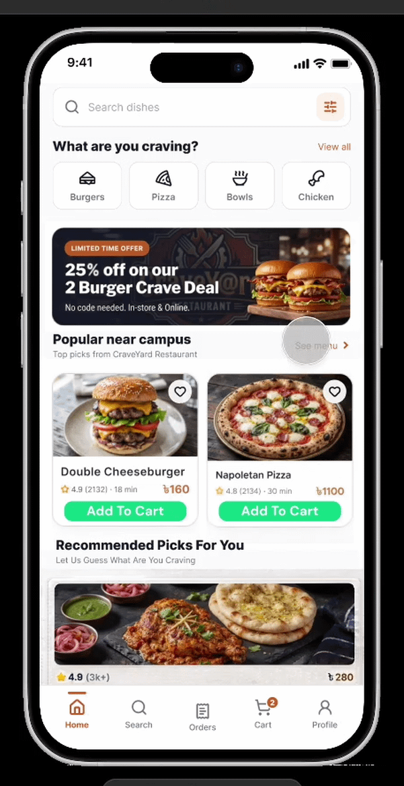

Connecting every button into a flow
06 · PROTOTYPING
1
On tap
Every card and button has a trigger
2
Open overlay
The customise sheet slides up over the menu
3
Navigate
Add to cart leads straight to the basket
Address & Payment
Order Placement
Cart
Notes:
We connected every tappable element. Tapping a dish card opens the item details as an overlay that slides up, and the add to cart button takes the user to the basket. We checked each screen so there are no dead ends and the whole journey can be tested end to end.

Slide 10
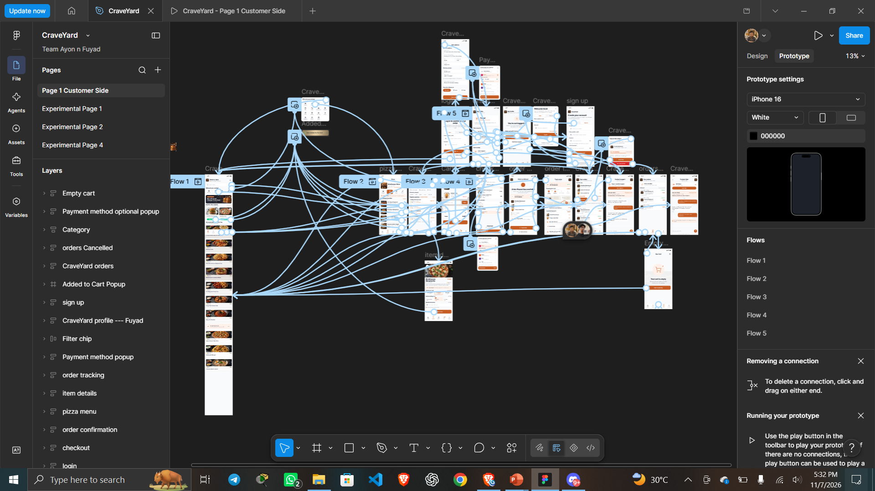
Interaction settings behind the flow
06 · PROTOTYPING
1
Trigger: On tap
Cards, buttons, tabs and back arrows
2
Action: Navigate or overlay
Screens navigate, sheets and pop-ups open as overlays
3
Animation: smooth
Slide up for sheets, smooth moves between screens
Notes:
In the Prototype tab, each connection has a trigger, an action and an animation. Most of ours are on tap. We used navigate for full screens, open overlay for sheets and pop-ups, and back for the arrows, with smooth transitions so the prototype feels like a finished app.

Slide 11
PART 2
App Functionalities
A screen-by-screen walkthrough of the CraveYard prototype
PRESENTED BY
WHAT YOU WILL SEE
Md Habibur Rahman Fuyad
Discover, order, track
ID: 0182420012101032
Home, search, menu and cart
Part 2 of the presentation
Payment, tracking and support
Notes:
Thank you, Ayon. I am Md Habibur Rahman Fuyad. I will now walk you through the actual screens of CraveYard, following a student from finding food to receiving the order.

Slide 12
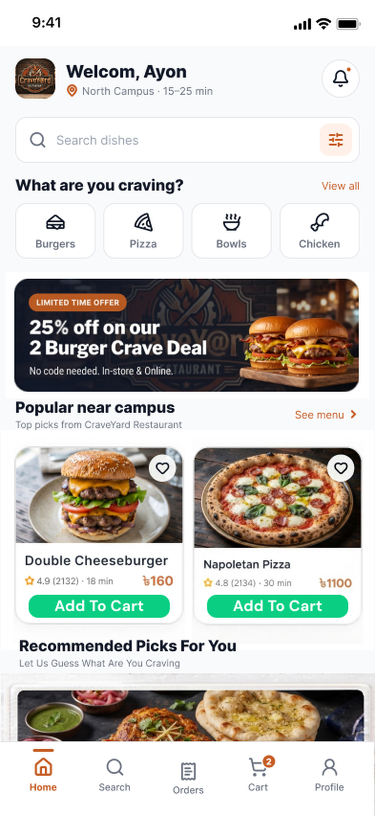
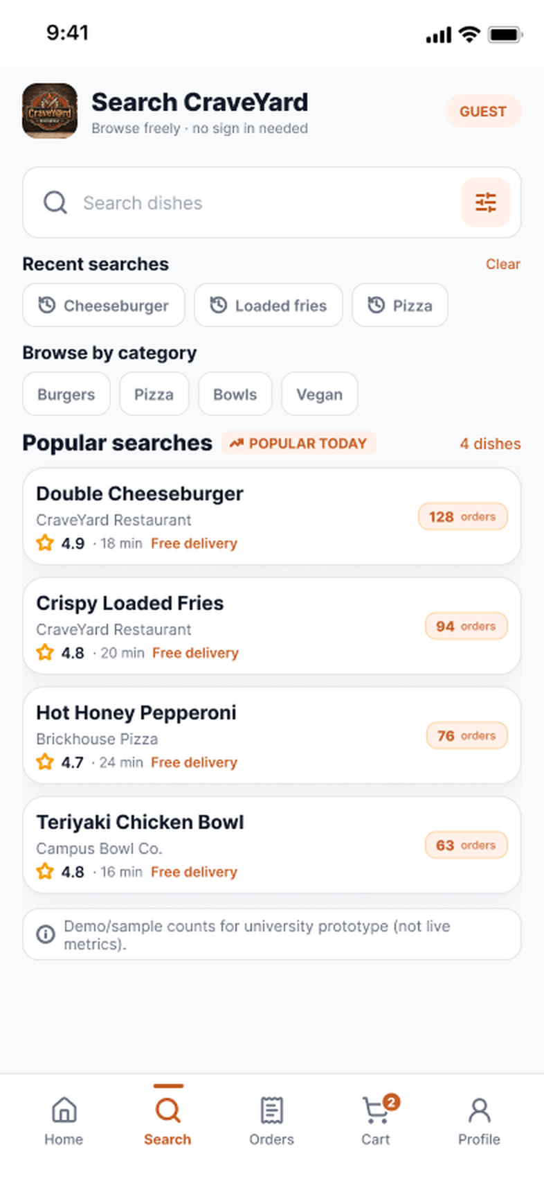
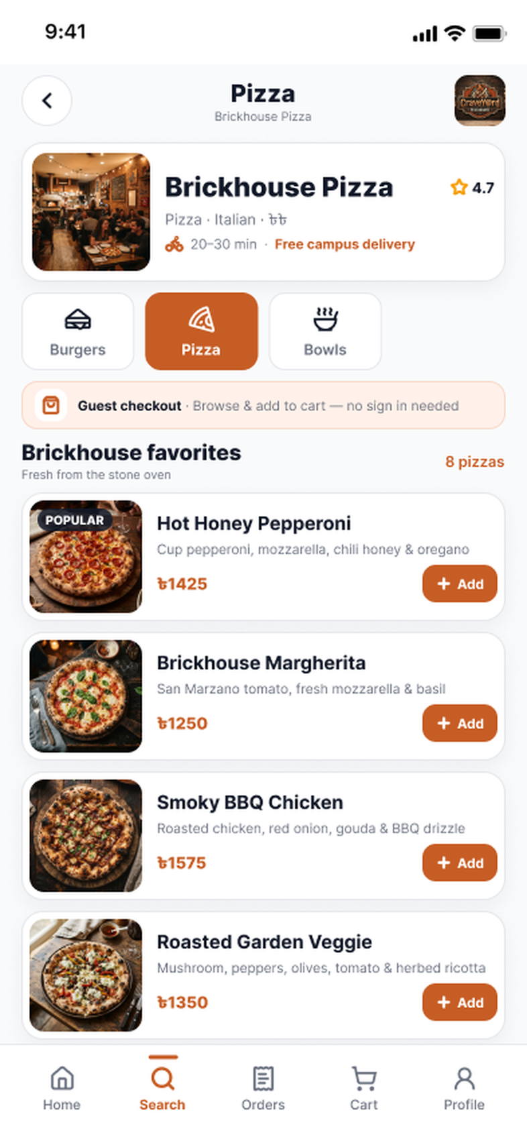
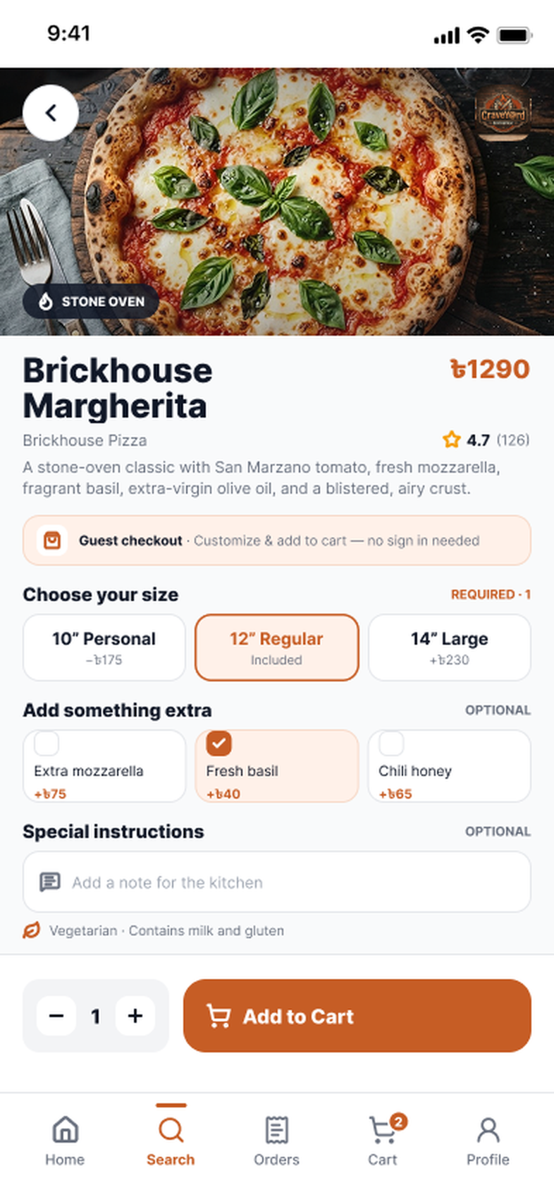
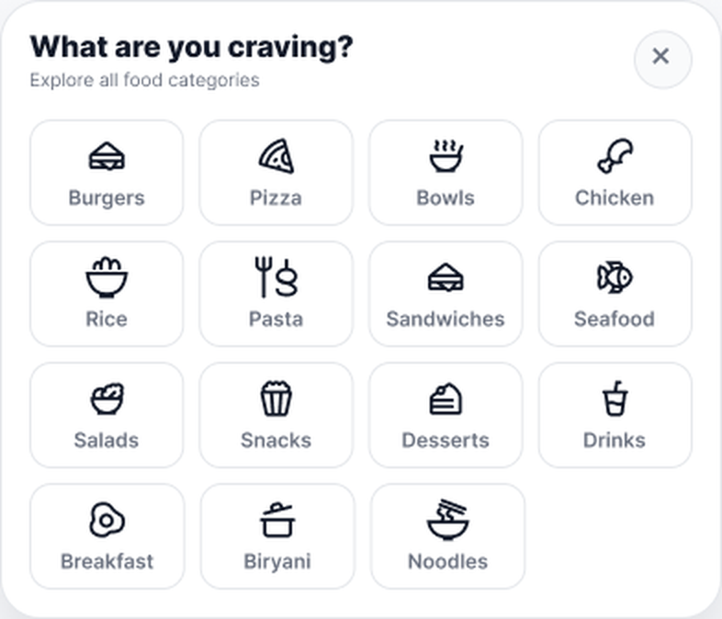
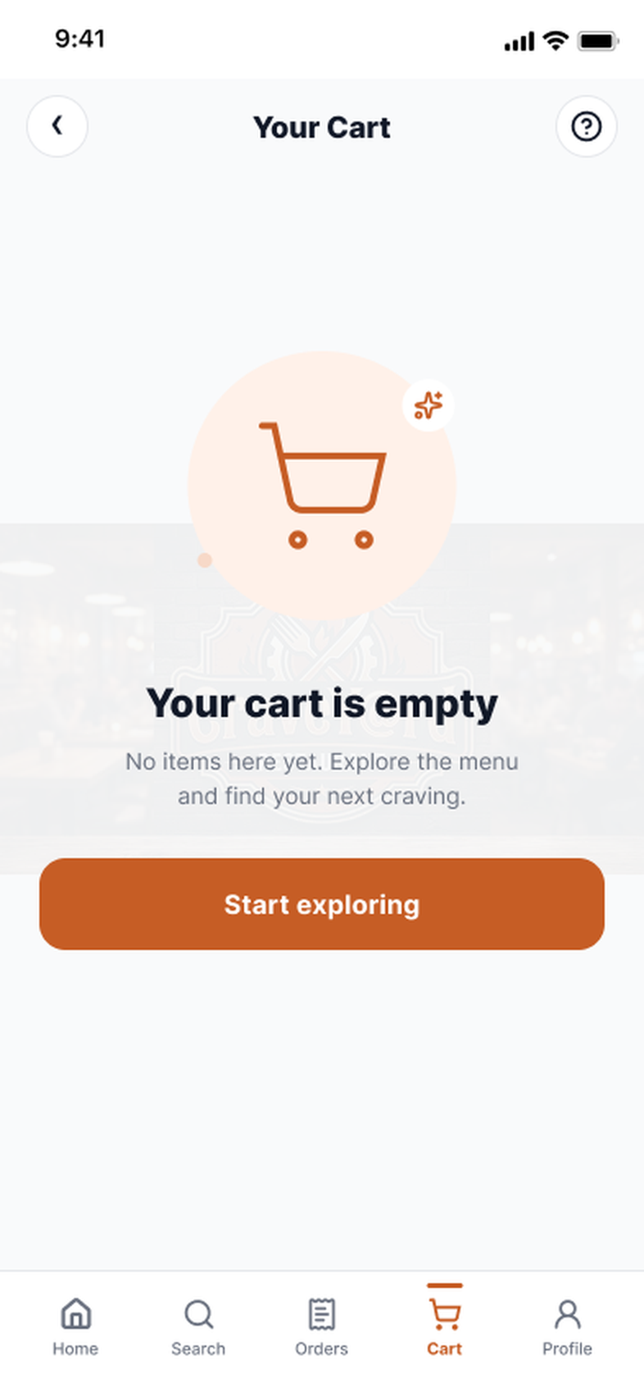
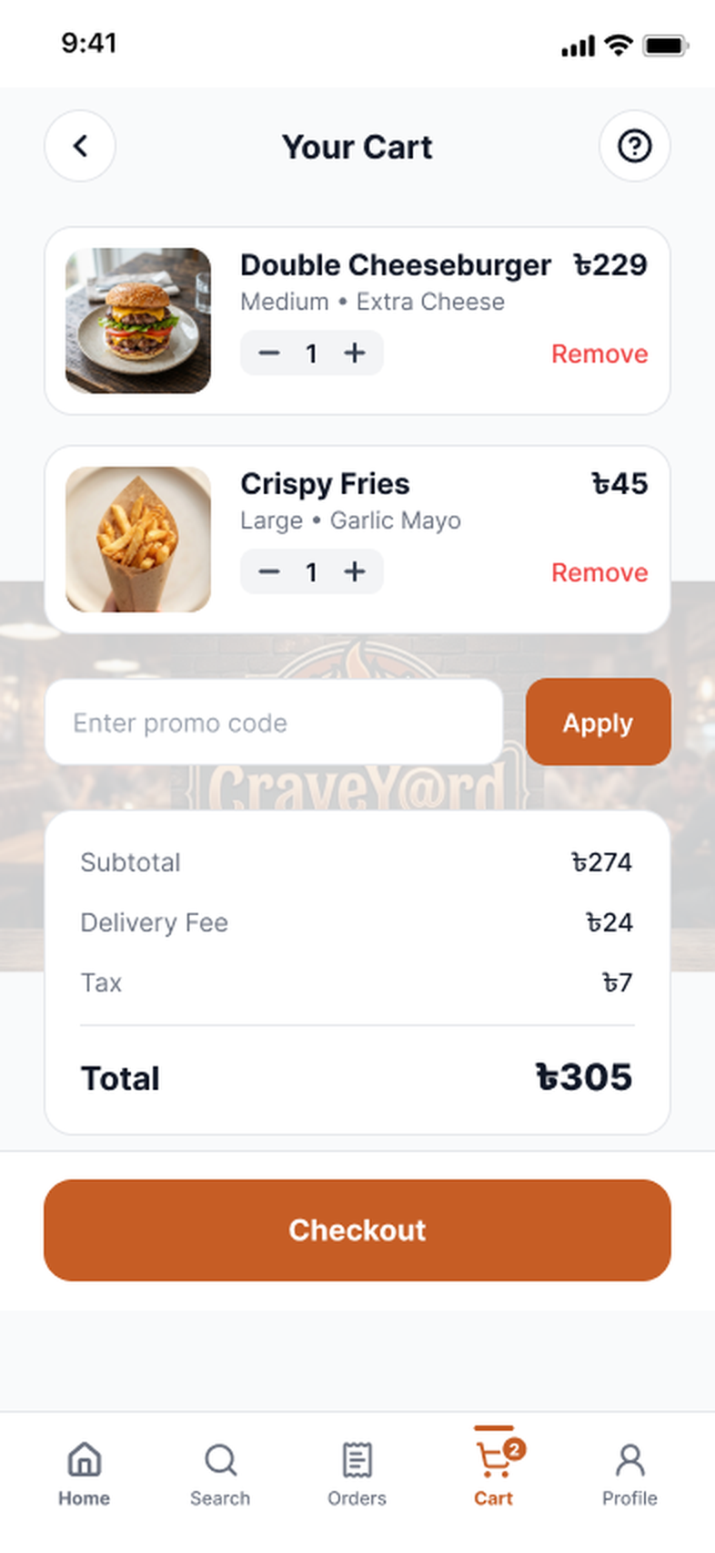
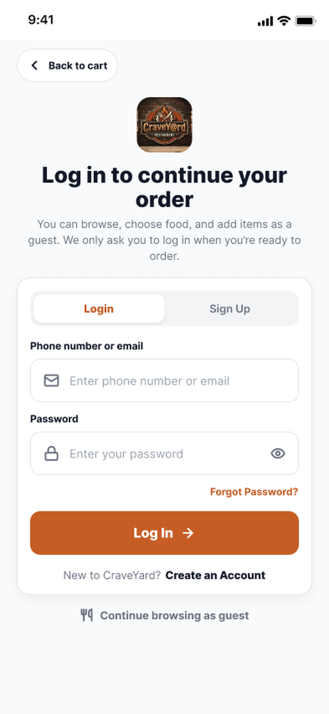
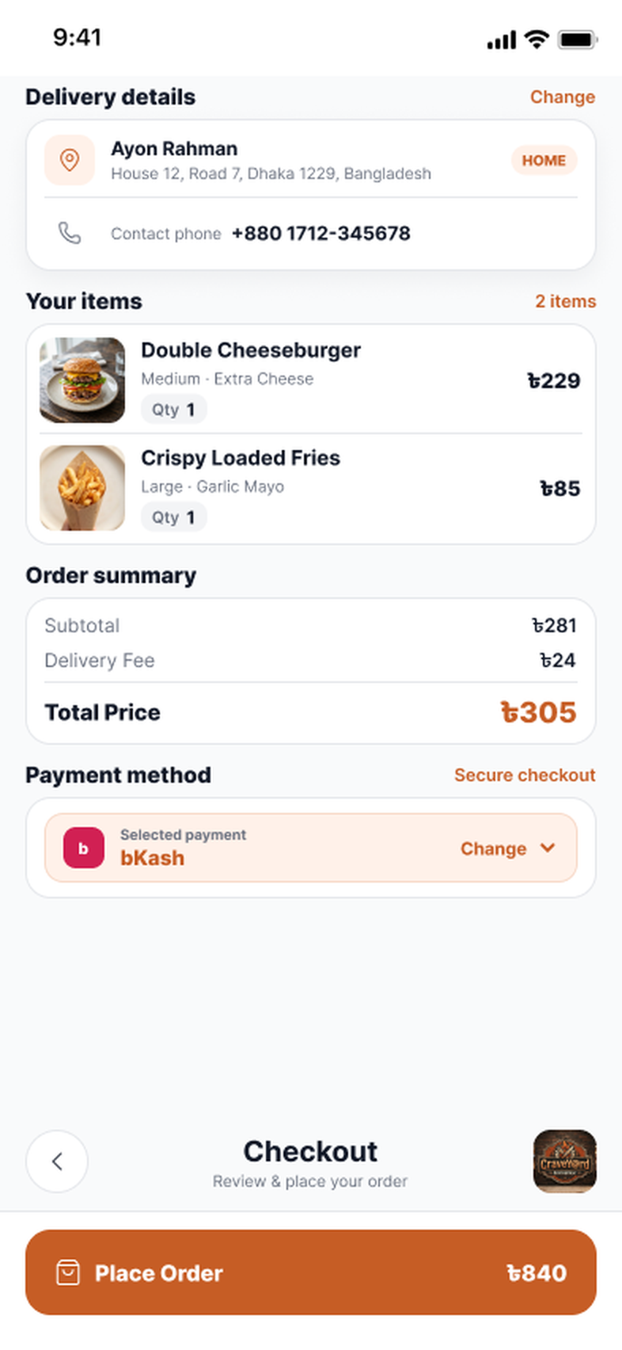
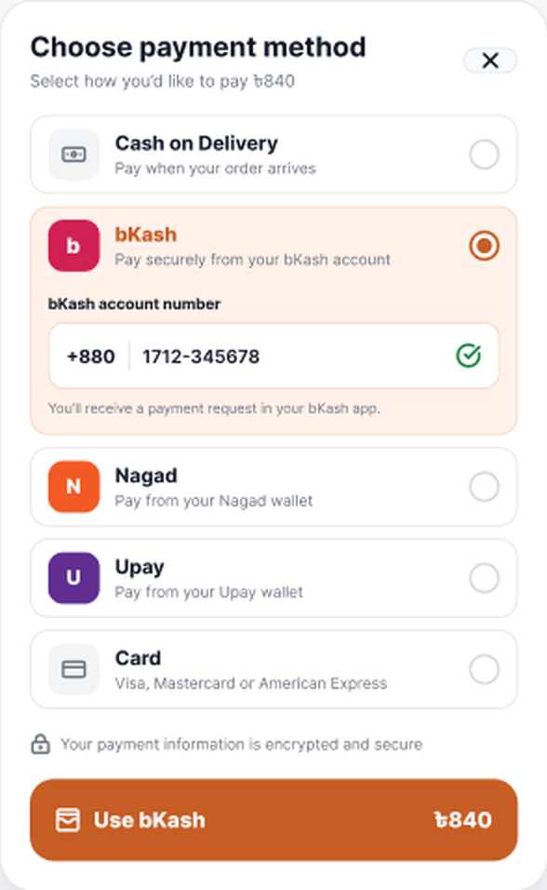
PART 2 • FUYAD •
Workflow / Prototype in a Glimpse
From the home screen to payment: how a guest or student moves through the prototype. Continues on the next slide.
BROWSE & CUSTOMIZE
View all
Pick a category
Open restaurant
Select a dish
Home
Food categories
Search
Restaurant menu
Item details
CART & CHECKOUT
Add to Cart
Remove items
Checkout
Log in or guest
Change payment
Empty cart
Cart
Login or guest
Checkout
Payment method
Notes:
A quick map of the first half of the prototype. The arrows show which button or action leads to the next screen. Browsing and cart building work for guests; login is only asked at checkout. The empty cart is the state after removing items.

Slide 13
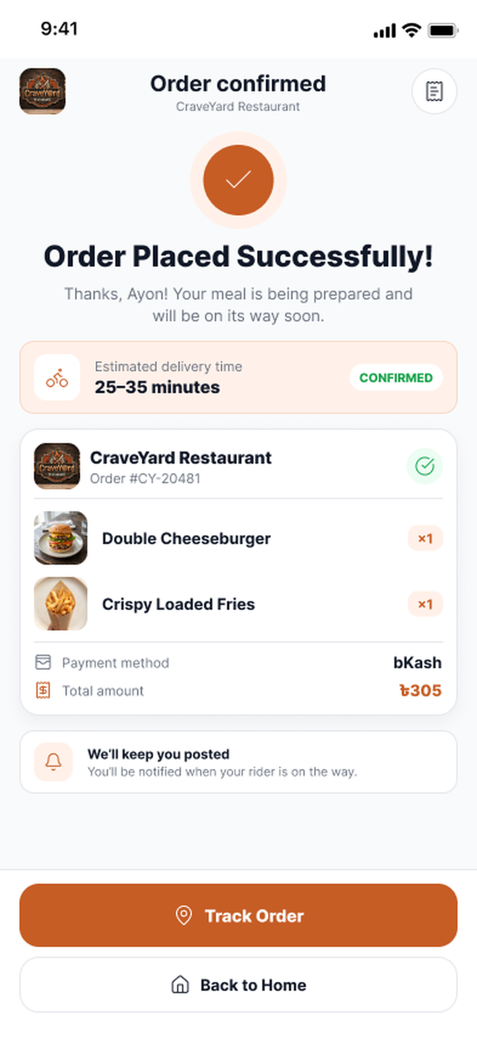
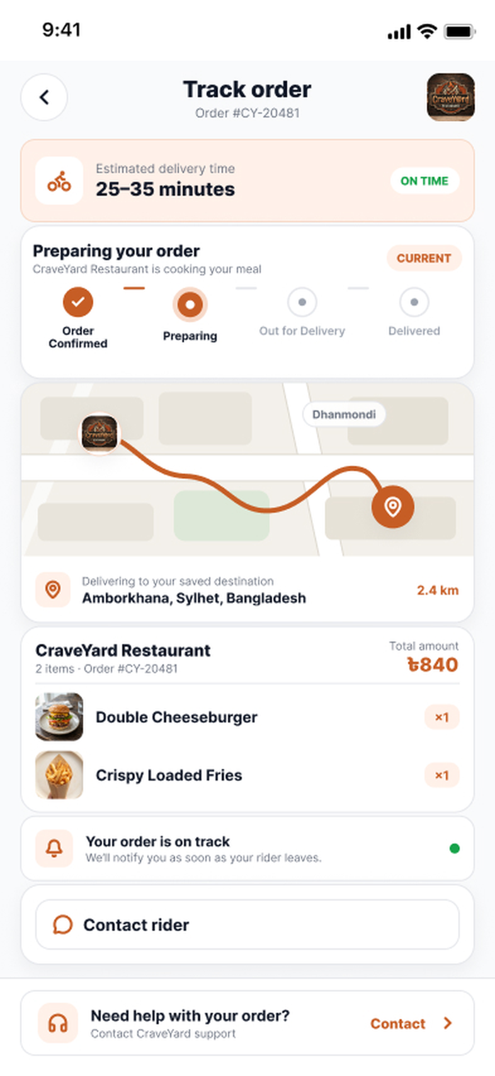
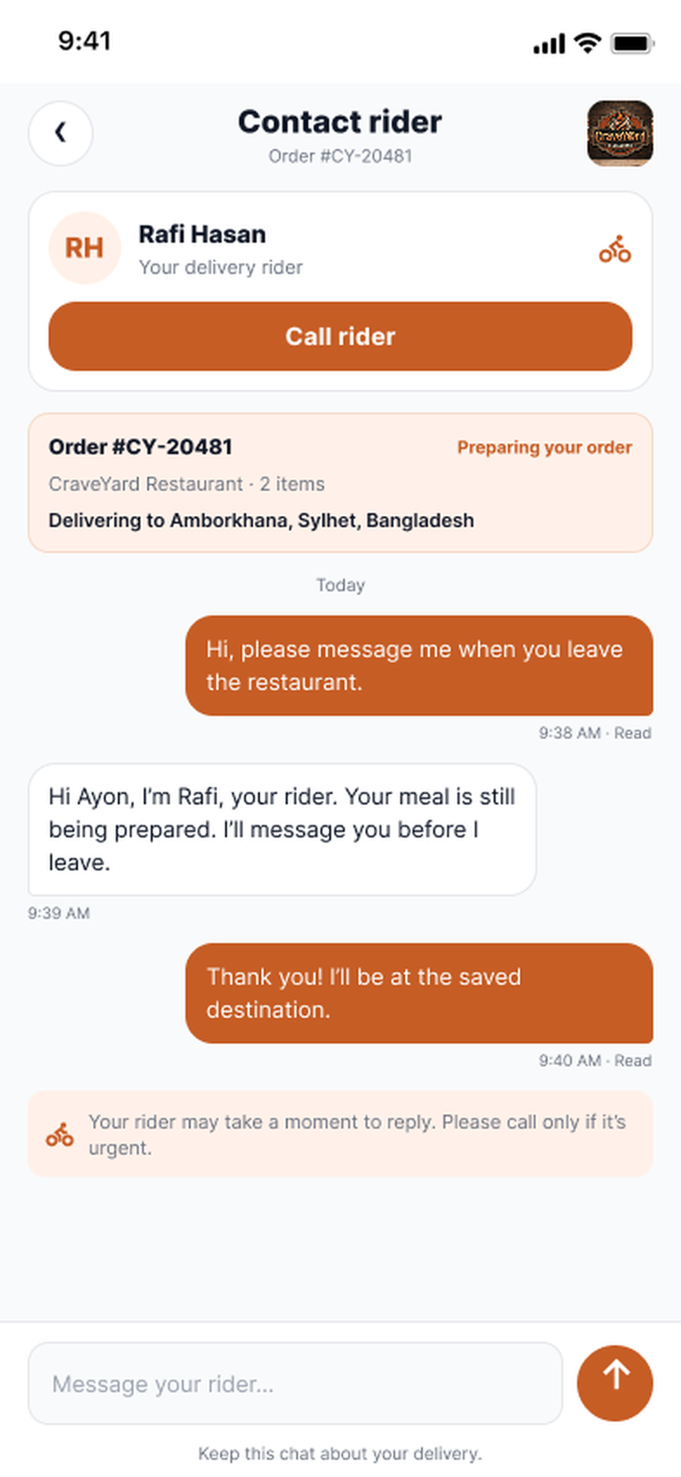
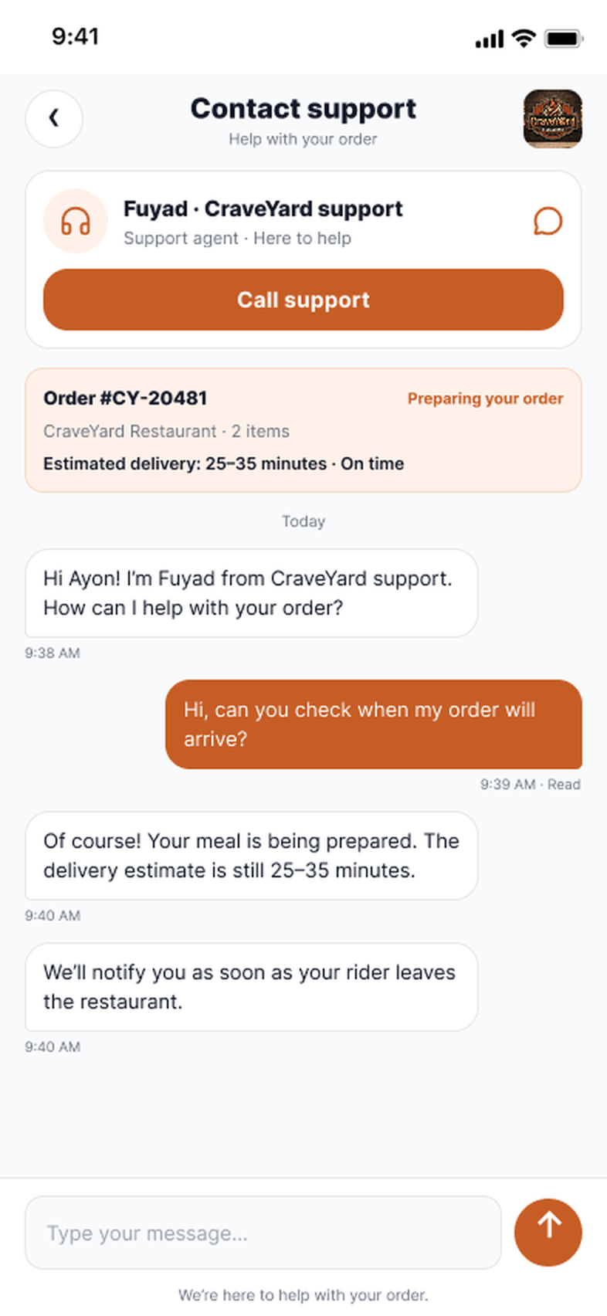
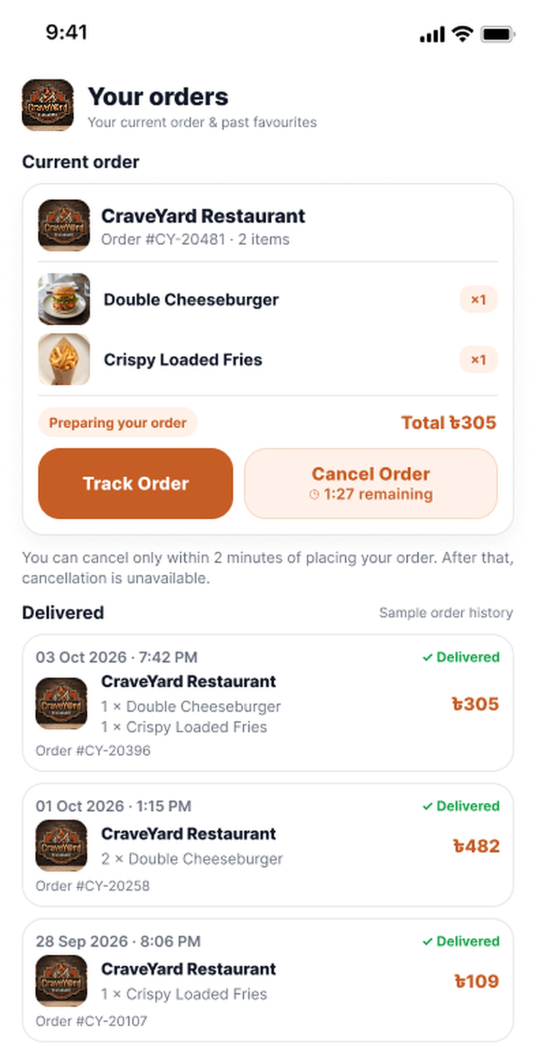
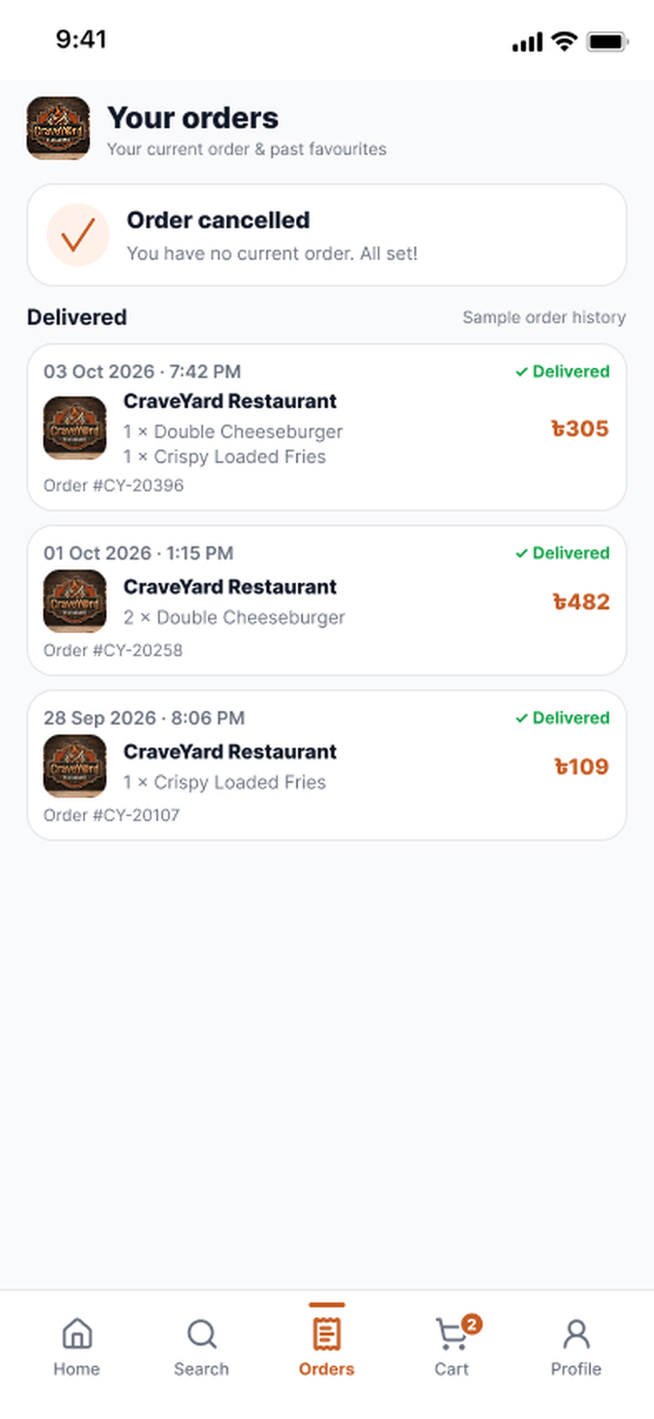
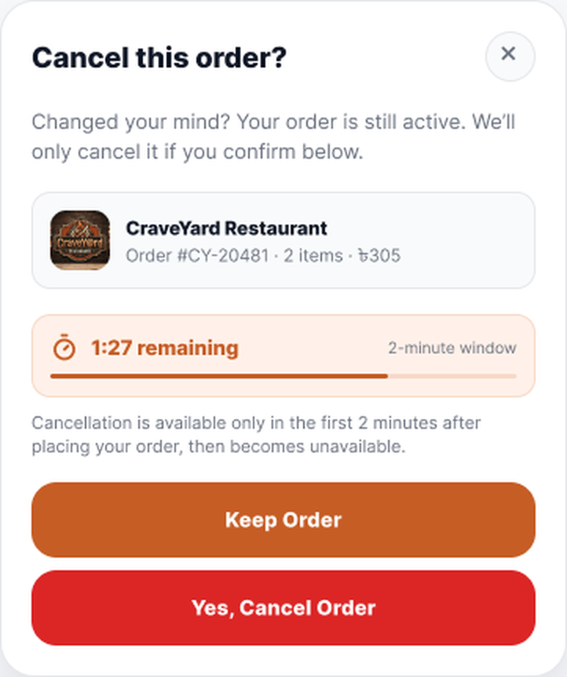
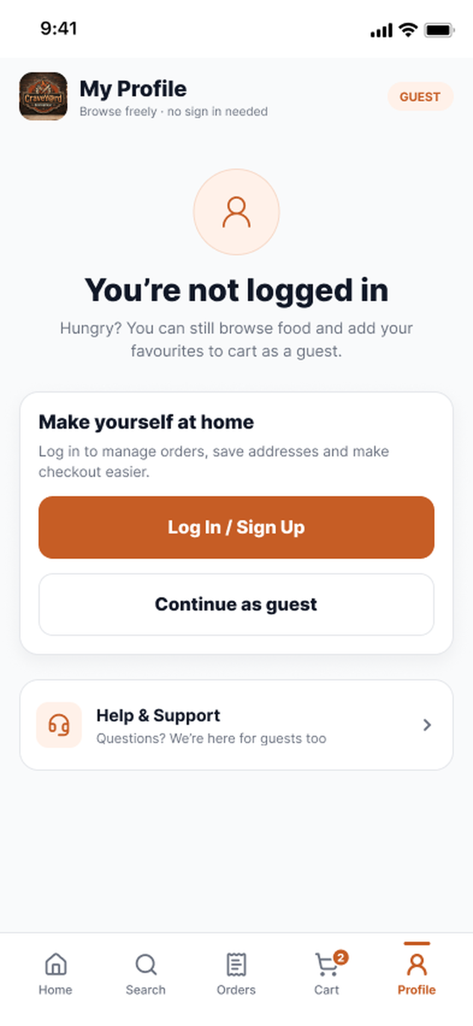
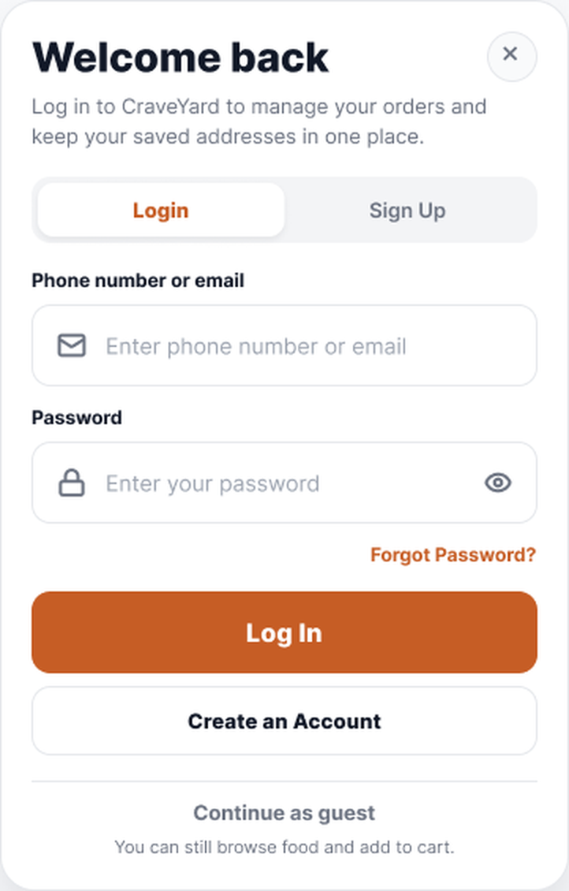
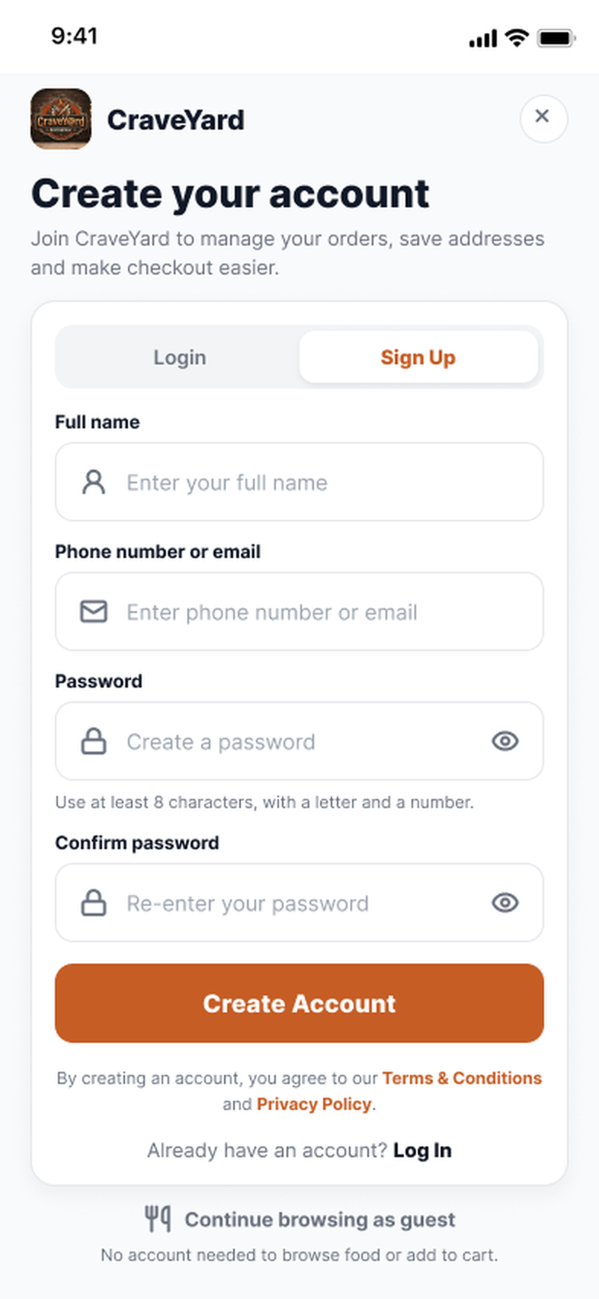
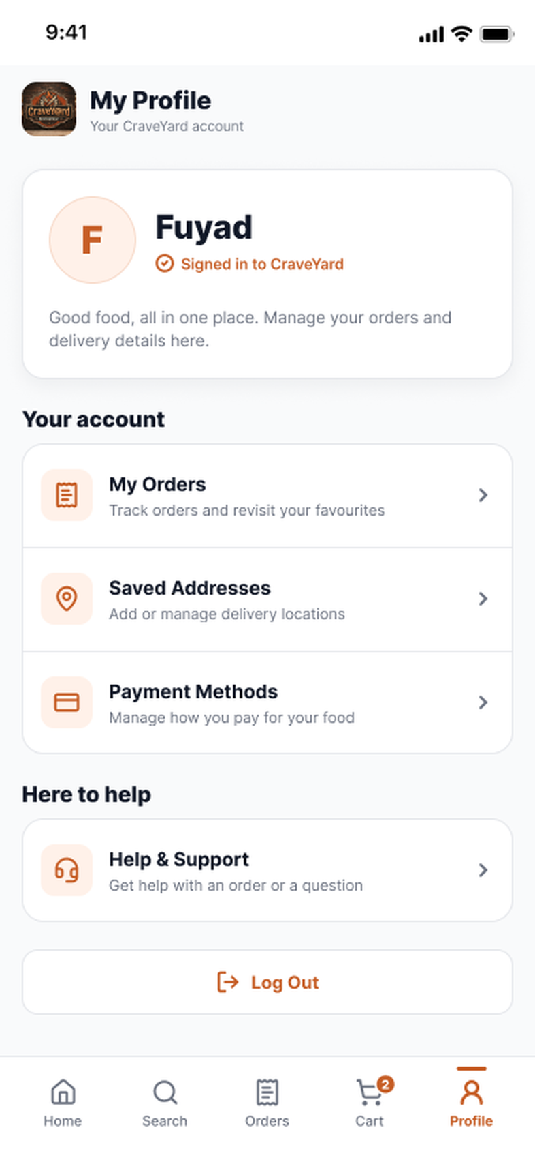
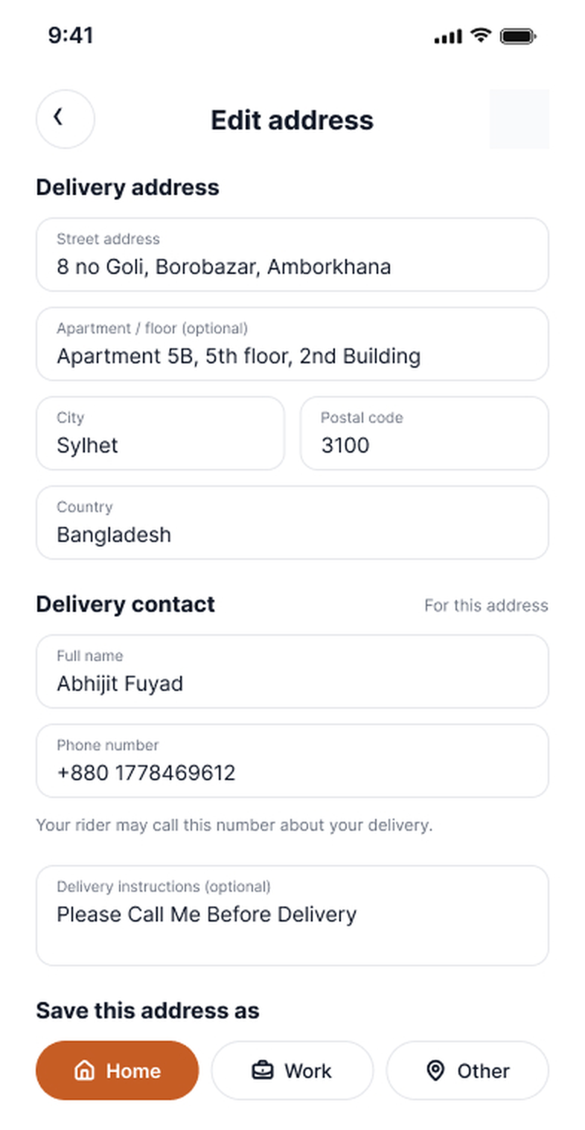
PART 2 • FUYAD •
Workflow / Prototype in a Glimpse
After Place Order: confirmation, tracking, support and cancellation, then the account screens.
TRACK & CONTACT
Need help?
CANCEL WINDOW
Track Order
Contact rider
Cancel
Confirm
Order confirmed
Track order
Contact rider
Contact support
Current order
Cancel this order?
Order cancelled
ACCOUNT
Log In / Sign Up
Create an Account
Create Account
Saved Addresses
Profile (guest)
Log in popup
Sign up
Profile (logged in)
Edit address
Notes:
Second half of the prototype. After placing an order the student sees a confirmation, can track the order and contact the rider or support, or cancel within the 2-minute window. The bottom row shows the account path from guest profile to login or sign-up, and then saved addresses.

Slide 14


PART 2 • FUYAD
Discovery, search and restaurant menu
Customers start from a campus-aware search screen and land on a menu built for quick ordering.
Campus-first search
Search CraveYard with no sign-in needed. Recent searches sit under the field so repeat orders are one tap away.
Browse by category
Burgers, Pizza, Bowls, Vegan and Non-Veg chips filter the list instantly.
Popular today
Dishes show ratings, free-delivery tags and sample order counts to help students pick quickly.
Menu at a glance
The restaurant page shows rating, 20–30 min delivery, a favourites list with prices and a quick Add button.
USER OUTCOME Find a dish and open its menu in a few taps.
SEARCH
RESTAURANT MENU
Notes:
Search is open to guests, so nobody has to register just to look around. Category chips and popular searches shorten the path to a dish. Opening a restaurant shows its rating, delivery time and favourites with a quick Add button. Order counts are sample data for the prototype.

Slide 15


PART 2 • FUYAD
Item customization and cart
Customers shape the dish in a bottom sheet, then review a transparent cart before checkout.
Choose a size
Size options such as 10", 12" and 14" are required, so every order has a clear portion.
Optional extras and notes
Add-ons like extra mozzarella, fresh basil or chili honey are tickable, with a note field for the kitchen.
Quantity steppers
The cart has + and − controls and a Remove link, so changes need no extra screens.
Clear costs
Subtotal ৳274, delivery ৳24 and tax ৳7 add up to ৳305, with a promo code field above the total.
USER OUTCOME No surprises: Customers see choices and costs before paying.
ITEM OPTIONS
YOUR CART
Notes:
On the item sheet the size is required and extras are optional. Add to Cart carries the choice into the cart, where quantities can be changed and the bill is itemised: 274 plus 24 plus 7 gives 305 taka. The promo code field sits right above the total.

Slide 16


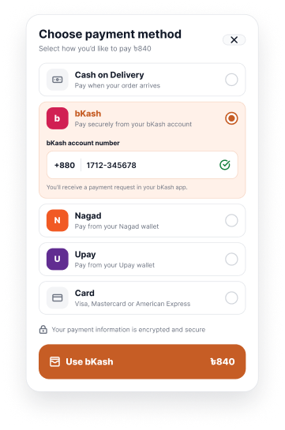
PART 2 • FUYAD
Sign in, checkout and payment
Checkout asks for an account only at the last moment and supports the payment options students actually use.
Guest option
The login gate lets students log in, sign up or continue browsing as a guest.
Delivery and summary
Checkout shows the saved address, contact phone, items and price summary on one screen.
Local payment methods
Cash on Delivery, bKash, Nagad, Upay and Card are listed in one sheet.
bKash number entry
Choosing bKash reveals a number field and a payment request note before the pay button.
PAYMENT
USER OUTCOME Quick checkout, local payments.
LOGIN OR GUEST
CHECKOUT
Notes:
Account creation is deferred to the point it is needed, and guests can keep browsing. Checkout gathers address, contact and summary. The payment sheet offers cash, bKash, Nagad, Upay and card; selecting bKash asks for the account number. Amounts differ between screens because these are prototype frames.

Slide 17


PART 2 • FUYAD
Order confirmation and tracking
After paying, Customers get a receipt-style confirmation and a live view of the order.
Confirmation screen
Order Placed Successfully shows the estimated 25–35 min delivery time and the ordered items.
Progress stages
Order Confirmed, Preparing, Out for Delivery and Delivered show where the order is.
Route and distance
A map shows the courier route to the saved destination with a distance of 2.4 km.
Help in one tap
Track Order, Contact rider and a help link are on the same screens.
USER OUTCOME Customers always know what happens next.
CONFIRMATION
TRACKING
Notes:
The confirmation screen reassures the student that the order is placed and gives a delivery estimate. Tracking breaks the order into four stages, adds a route map and distance, and keeps contact buttons close by.

Slide 18

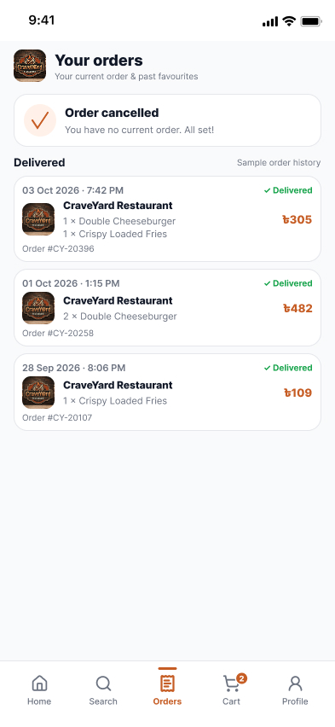
PART 2 • FUYAD
Cancellation window and order history
A short safety window covers accidental orders, and past orders stay easy to review.
2-minute cancel window
The current order shows a Cancel Order button with a countdown (1:27 remaining in the prototype).
Clear limit
A note explains that cancelling is only possible within 2 minutes of placing the order.
Cancelled state
A confirmation banner says the order is cancelled and there is no current order.
Order history
Delivered orders list restaurant, items, date and total so students can review past purchases.
USER OUTCOME Fast mistakes are fixable, and the rules are clear.
CURRENT ORDER
ORDER CANCELLED
Notes:
Right after ordering, the Orders tab shows Track Order and Cancel Order with a countdown. The note explains the 2-minute limit. Once cancelled, the screen confirms it, and the history below lists earlier delivered orders.

Slide 19
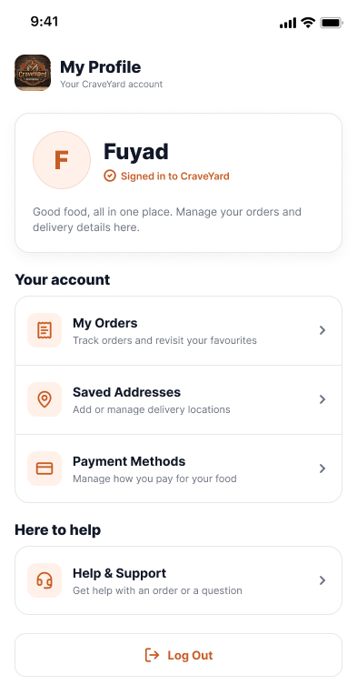

PART 2 • FUYAD
Profile and saved addresses
Account screens keep repeat orders quick for students who order often.
Account hub
My Profile links to My Orders, Saved Addresses, Payment Methods and Help & Support, plus Log Out.
Signed-in identity
A profile card shows the account name and signed-in status.
Detailed address form
Street, apartment, city, postal code and country, plus a delivery contact name and phone.
Save as Home, Work or Other
Tags and delivery instructions are saved so the next checkout starts filled in.
USER OUTCOME Repeat orders start with details already filled in.
MY PROFILE
EDIT ADDRESS
Notes:
The profile is the hub for orders, addresses, payments and help. The address form collects everything a courier needs, including a contact number and delivery note, and can be saved as Home, Work or Other.

Slide 20
t
To Access The Figma Prototype Click Here
CRAVEYARD • An Interactive App Prototype
Thank you
https://www.figma.com/proto/1PROToz0KNfgW5iBXlRph6/CraveYard?node-id=38-473&p=f&viewport=80%2C269%2C0.13&t=6gQoNAUOX9cslduE-1&scaling=scale-down&content-scaling=fixed&starting-point-node-id=38%3A473&show-proto-sidebar=1&page-id=0%3A1
Questions and discussion
Abhijit Das Ayon
0182420012101038
Batch 64 A CSE
Leading University, Sylhet
Md Habibur Rahman Fuyad
0182420012101032
Batch 64 A CSE
Leading University, Sylhet

